Slide 1
Multimedia Coding

Slide 2
Multimedia Coding Week 1

Slide 3
Past Coding Experience
I’ve known about coding for many years and took part in computer science lessons when I was younger. However, as I was younger I was more easily distracted and essentially sat playing Minecraft through the lessons which resulted in me getting an E. I always found the coding difficult therefore I procrastinated getting any of the work done.
With this module I already feel so much more positive about getting the work done as it is really fun and I’m really enjoying learning something new. I have very little coding knowledge and no HTML knowledge at all so I initially thought this module was going to be the worst module for me and that it would put me in the direction of failing the course.
However, as of writing this I am actually already three weeks into the module and I am loving every minute of it. It’s probably my favourite module so far out of all of the ones I am currently studying.

Slide 4
First Week Test Site
To start off the module I was told to create a basic website and change the tab header and add a couple of headings within the body of the website. I did this pretty easily and I actually picked up HTML a lot easier than I thought I would. By the end of the first week I had already got the task done and I had additionally added a favicon.

Slide 5
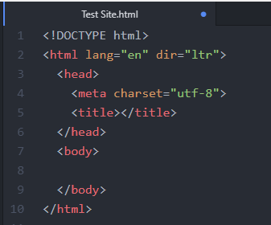
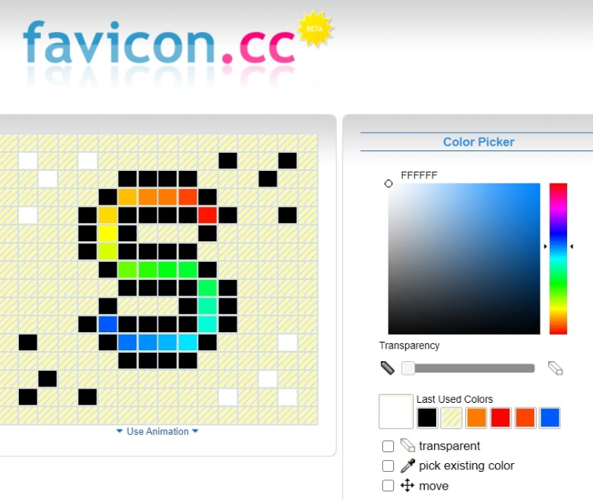

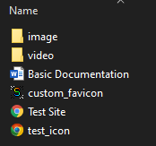
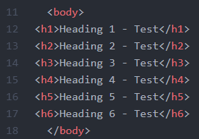
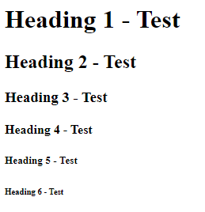
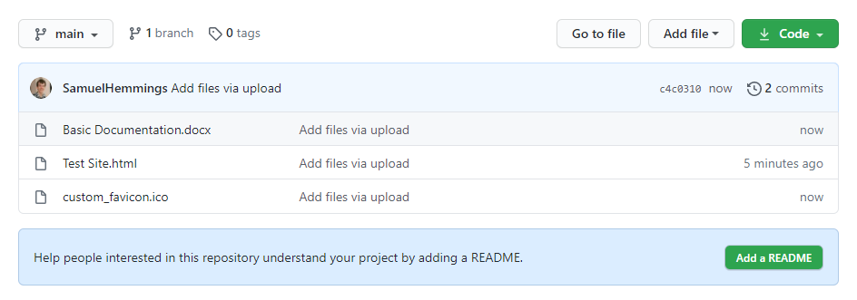
First Week Test Site
I started out by following the basic steps of creating a html document by using typing out “html” into the new atom project and pressing tab to auto complete it. I then entered in a title which will show up on the browsers tab by inserting HTML Testing | Samuel into the <title> angle brace.
I decided that the default favicon on the browser tab was not good enough so I found an online favicon creation tool which allowed me to create my own pixel style icon which I can save and embed into a HTML page. Link: https://www.favicon.cc/
I also made sure all my files were organised and in the relevant folders. I created two folders for both images and videos and made sure my favicons were in the root directory of my HTML file.
To practice using the <body></body> function I made multiples lines of code which give demonstrations of each of the headings. On the website this displays text for each heading.
I then added a meta tag to make the web page more mobile friendly as recommended to do so in one of the videos. I followed along adding the code line as shown below.
Once I had the basic code working, I went to create a GitHub account. For some reason there was one already there so I may have made one before watching the video on how to make one. Not sure if this is a problem but I have two names on there. One as my full name and one with the P Number.

Slide 6
Multimedia Coding Week 2

Slide 7
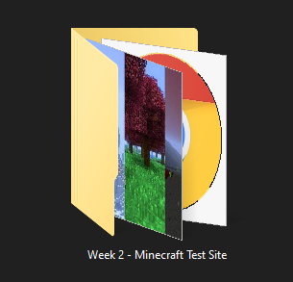
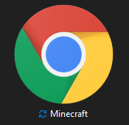
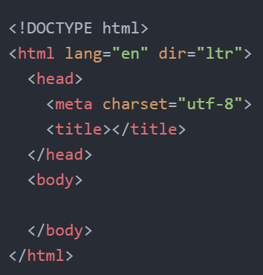
Multimedia Coding Week 2
It is now week two and I started fresh with a whole new website page. I decided to give this page a theme instead of just adding the elements to a blank page one at a time each week. This way every time I learn a new feature, I can use it within my themed website and hopefully at some point have a decent site with multiple pages, audio, videos and more. Considering I had zero HTML experience before starting week one of this module I have made significant progress. In my opinion at least. Below I will explain briefly the progress I have made during week two and how I did what I did.
I started out by creating a new folder for all my week 2 files. I then created a new HTML file and opened it with Atom so I could start easily editing it and adding content to the blank page.
I started out by typing “HTML” into the document and pressing tab which automatically gave me the starter code to create a basic website. From there I added my own content and expanded.

Slide 8
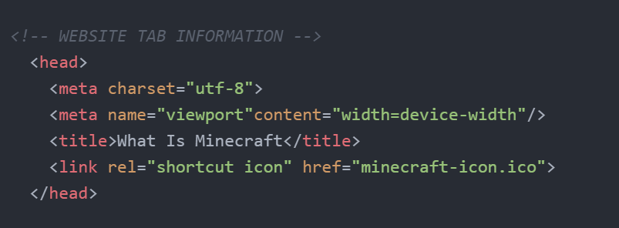
Heading / Tab Info
To start with I created the heading and added information for the browser tab such as the tab title and the favicon. The favicon is the little icon next to the title.
I did this by linking the “minecraft-icon.ico” file inside of the head section of the code.

Slide 9
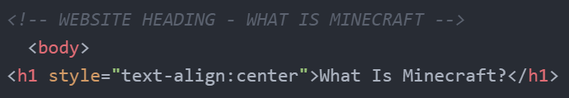
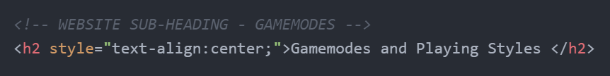
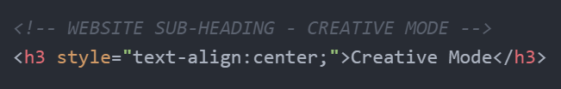
Headings and Importance
Throughout my page there are currently three types of heading. These headings are labelled as <h1>, <h2> and <h3>. These numbers show the importance of each heading and determine the size and general properties of the heading. My first heading at the top of the page is a <h1> heading as it is the most important heading on the entire page.
My first section of sub-headings are in the <h2> style as they are of the secondary class of importance as they are not too important but they still need to be shown. In the website these are essentially my sub-categories for the different Minecraft topics I wanted to cover.
Lastly in each of the <h2> headings there are multiple <h3> headings which are of the third class of importance as they are sub-headings within the secondary ones.

Slide 10
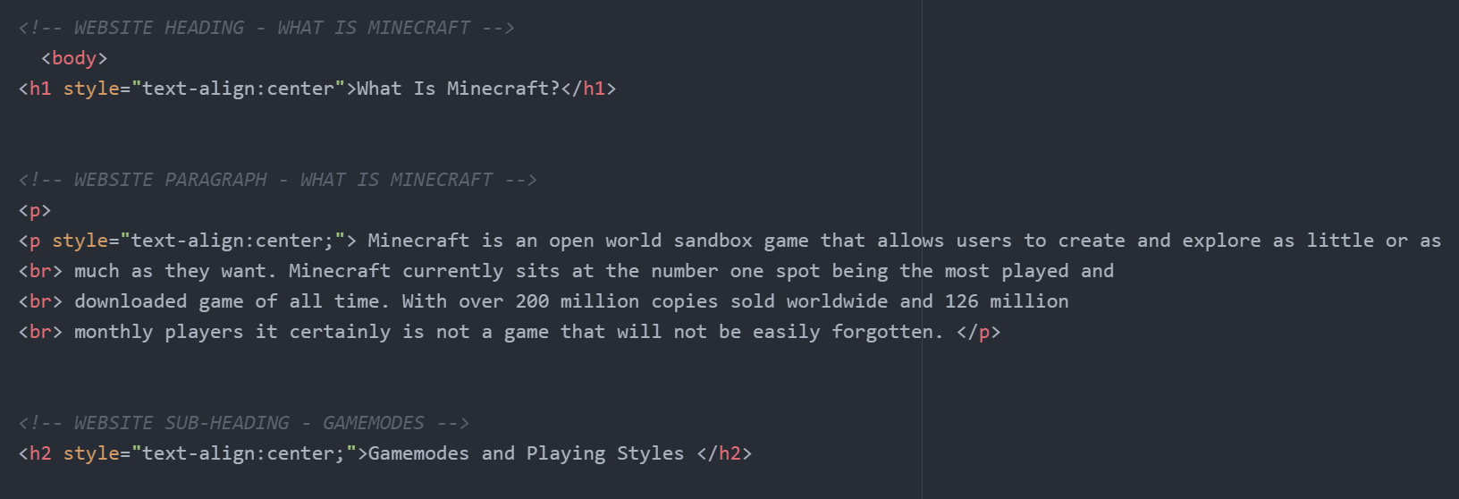
Headings and Paragraphs
Of course at the moment my website is just an empty page with a background so I needed to start adding some text while also sticking to the criteria of the task set which I will get to later on. As you can see by the image below I added two sub headings (arrowed in red) and a paragraph (arrowed in blue).
As I was unsure on how to directly format a website to work with mobile I decided that keeping everything centred would be the best idea for the time being as it would work across multiple devices and screen sizes. As you can see from the first red arrow at the top of the image I aligned my most important heading and also did the same for the paragraph and the next subheading following after that. This keeps everything in the middle of the page instead of being pushed to one side.

Slide 11
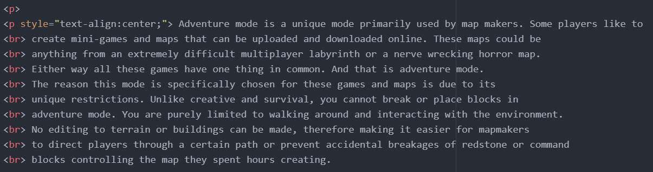
Paragraphs and Breaks
Within my page I added multiple paragraphs which were formatted and aligned to correctly fit within the centre of my web page. To create a paragraph I added multiple <br> tags. This tag is a break tag and essentially forces the text to go to the next line automatically at any point.
As you can see by this paragraph below explaining what adventure mode is, the code starts with a text align style element and is followed by the start of the paragraphs text. I then create a break tag by using a break tag. I repeat this multiple times until it fits in the page nicely. The reason I do this is so the text does not appear outside the middle section of my page.

Slide 12
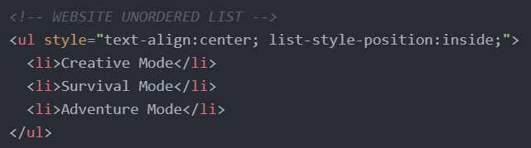
Ordered and Unordered Lists
Within one of the tasks we were instructed to add some lists to our websites to show that we understood how to use them and to also practice more elements of HTML.
My web page at this current moment has two unordered lists each containing three list elements each. To create a list I used the <ul> and </ul> tags to create an unordered list which is a list that is simply not ordered (example: 1, 2, 3 and so on). These lists just use bullet points instead. Inside the two unordered list tags I placed three list items. I did this by typing out <li> text </li>
Ordered List
Unordered List
Survival Mode
Creative Mode
Adventure Mode
Survival Mode
Creative Mode
Adventure Mode

Slide 13
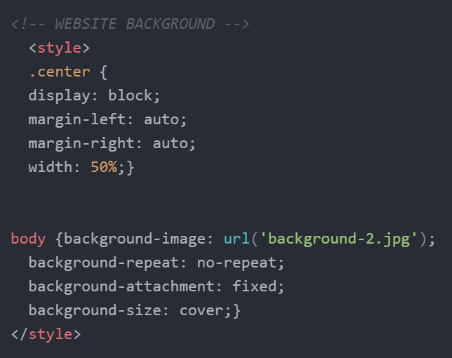
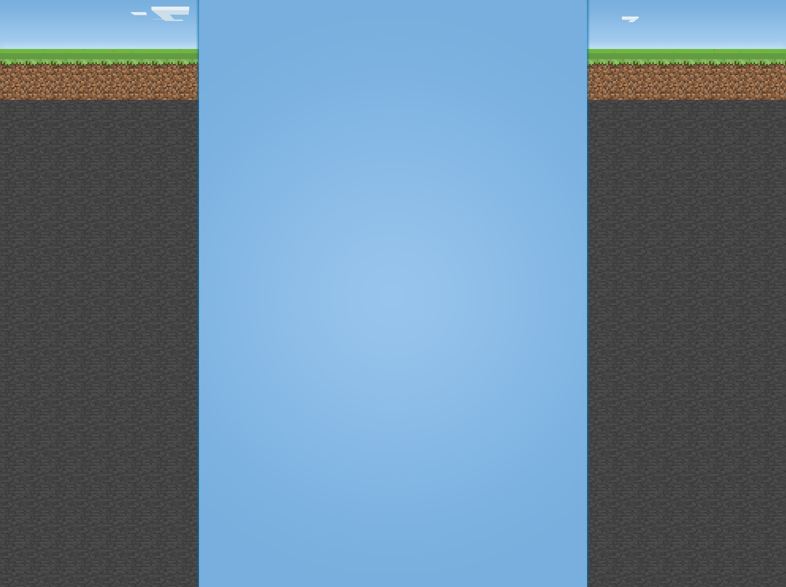
Website Background Graphics
In week one the test site I created had a blank white background with simple black headings on it. I wanted something a bit more colourful so instead of just changing the RBG or hex value of the background I decided to add an image.
I found some basic background code on W3Schools for backgrounds and copied it across. I studied the code a little to try and understand how it worked. I also changed multiple parts to allow it to work for my website specifically.
I set the background image to the file I had stored inside the root directory of the HTML file. I will most likely change this later on to import from a specific image folder as that would make my file management easier.
I also did not want the image to repeat or have any extra assets so I made sure the “no-repeat” option was added in the lower half of the code.

Slide 14


Greyed Out Text
All throughout my code there are several titles which are made up of greyed out text. This code is code that the website will automatically ignore and will not print directly onto my webpage.
I added these lines specifically for organisation. It is really useful to be able to scroll through my code and easily know exactly what the code is without reading through it all. Essentially if I want to find a certain piece of code I will scroll down and read the headings and then that will tell me if the code below it is what I was looking for.
This generally makes my workflow a lot more efficient and allows me to code faster as I can navigate through my already written code with ease.

Slide 15
Multimedia Coding Week 3

Slide 16
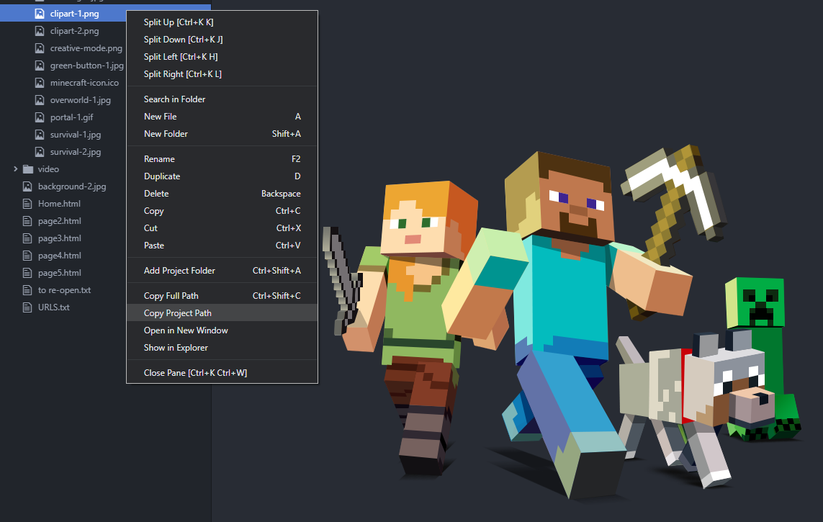
Image Sourcing and Media
As well as text I also have several parts of the code that link to images or non-text media. Linking an image is pretty straight forward. To add an image I just used the <img src> tag. To get this I just typed “img” and pressed enter. This gave me the pre-set code for inserting images.
I added images by having the images in the root directory of where the HTML file is located. This means all I had to do is add the image source into the code. So if my image was called “clipart-1.jpg” I would just enter that directly into the code. (See image below)
After the week three lecture I learned how to import images from other folders other than the root folder. The line of code is the exact same apart from you have to copy the project path of the specific image you want. So I would just find it in my file browser within Atom and then right click on an image and select “Copy Project Path”. This allows the HTML to find images from any folder within the main root folder which allows me to organise my files and make finding the correct file easier. So now I have several folders for different types of media.
To navigate up one step in the file path I can also add “../” to the start of my file path.

Slide 17
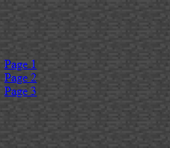
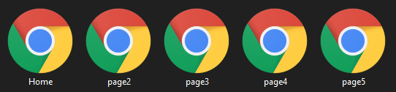

Anchors and Page Linking
To step up my HTML game I decided that I would want to add multiple pages and also add some buttons to navigate between them. Thankfully the lecture after I had this idea was actually to do with page anchoring and linking multiple HTML files together. So once I found out how to do it I had a couple of practice runs until I knew how to do it without a tutorial.
To start with I created four extra blank pages and linked them all with the default text. This creates some blue text which indicates that a link is attached. When this text is clicked it will send the user to the page set within the HTML code.
I also found out that by adding the target="_blank” style element allows all links to open in a new browser tab. Which is personally preferred as that way the original page is left open for users to return to after they have finished browsing the opened link.

Slide 18
Linking Within Pages
Explain how to link within a page
<h2 id=“example-id">example text</h2>
<a href="#example-id">example text</a>

Slide 19
Linking Emails and Phone Numbers
To link emails I can use <a href=“mailto:emailaddress”>Text</a>
Same goes for mobile phones but instead I can use <a href=“tel:+44phonenumber”>Text</a>

Slide 20
Multimedia Coding Week 4

